Slide 1

SPAM/HAM Classification
Project by Madan K

Slide 2
Business Problem:
Ham spam classification is a process of categorizing emails into two categories - ham (legitimate emails) and spam (unsolicited emails). Ham spam classification is essential in preventing spam emails from cluttering user's inboxes, causing inconvenience and wasting time.

Slide 3
Project Architecture / Project Flow
Loading Dataset
Descriptive Pre – Analysis of Reviews
Dealing With Duplicate Values
How?
Imputation
By Lemmatize or stem words , Combine duplicate values
Deletion
If the duplicate values are exact duplicates

Slide 4
Project Architecture / Project Flow
Text Preprocessing
Model Building
Model Evaluation
Deployment

Slide 5
INTRODUCTION
Ham spam classification is a process of categorizing emails into two categories - ham (legitimate emails) and spam (unsolicited emails). Ham spam classification is essential in preventing spam emails from cluttering user's inboxes, causing inconvenience and wasting time.
Ham spam classification involves several steps, including text preprocessing, feature engineering, model selection, and evaluation. Text preprocessing involves cleaning the text data by removing stop words, stemming or lemmatization, and removing special characters, punctuation, and numbers.
Feature engineering involves extracting relevant features from the preprocessed text data, such as word frequency, word count, and n-grams. Model selection involves choosing an appropriate algorithm for the classification task. Common algorithms used for ham spam classification include Naive Bayes, Support Vector Machines (SVM), K-Nearest Neighbors (KNN), and Random Forest. The choice of algorithm depends on various factors such as the size of the dataset, the complexity of the problem, and the performance metrics required.

Slide 6
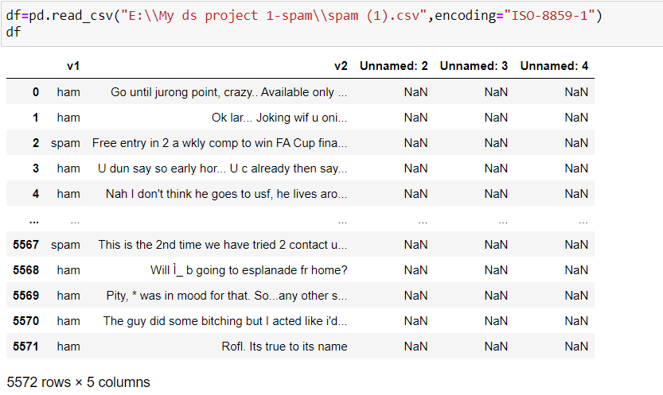
Objective:Ham spam classification is a process of categorizing emails into two categories - ham (legitimate emails) and spam (unsolicited emails). Ham spam classification is essential in preventing spam emails from cluttering user's inboxes, causing inconvenience and wasting time

Slide 7
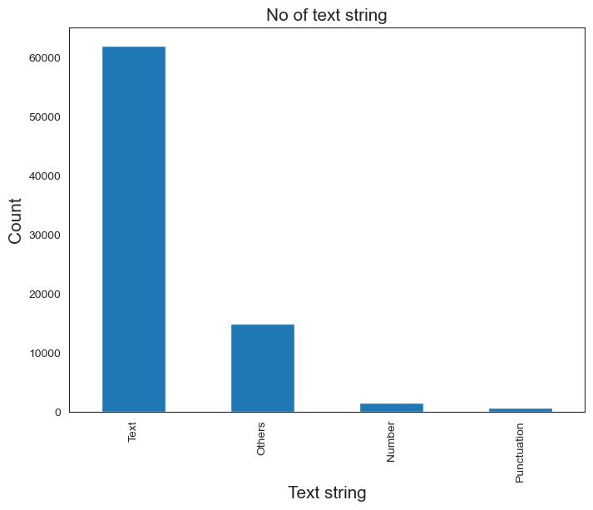
The bar chart data includes a total text count of 60000 approx, indicating the number of words or characters included in the reviews being analyzed.
There were 3463 instances of numbers included in the text data, which may be relevant for further analysis
The text data also included 2000 approx instances of punctuation, such as periods, commas, and exclamation points.
There were 10000 instances of "other" characters, which may include special characters or symbols that are not typically used in text, or characters from other languages..
Understanding the breakdown of text data by these different categories can provide insights into the characteristics of the reviews being analyzed.

Slide 8
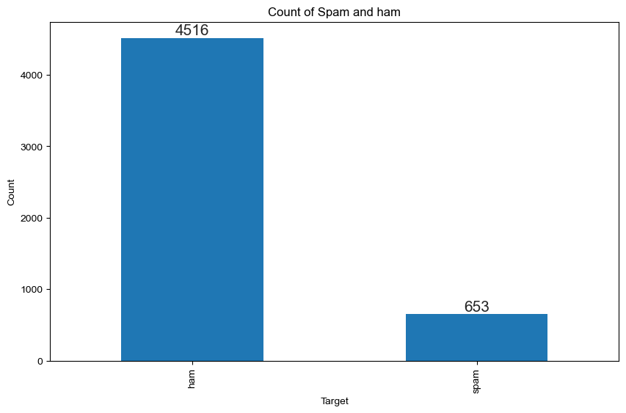
Ham mails are the majority classes having 4516 instances in given dataset and spam mails are minority class,clearly the given dataset is imbalanced

Slide 9

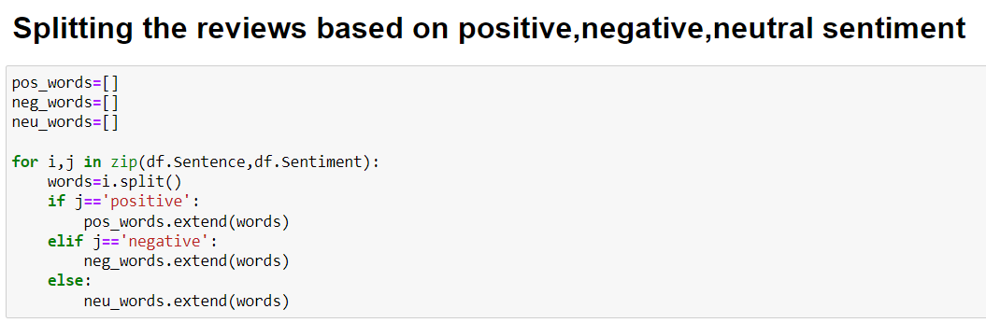
Pre-analysis of given data:
Pre-analysis involves preprocessing the text data to make it ready for ham/spam classification. This may include tasks such as removing stopwords, stemming or lemmatizing words, and converting text to lowercase.
The next step in pre-analysis is to categorize the reviews based on sentiment, which typically involves using a machine learning algorithm or a lexicon-based approach. Once the reviews are categorized, visualizations such as bar charts, word clouds, and histograms are used to analyze the data and gain insights.
Bar charts are used to compare the no of ham and spam words..
Word clouds can provide a quick snapshot of the most common words used in ham/spam category.
Histograms can help to identify the distribution of review lengths or the frequency of specific words.

Slide 10
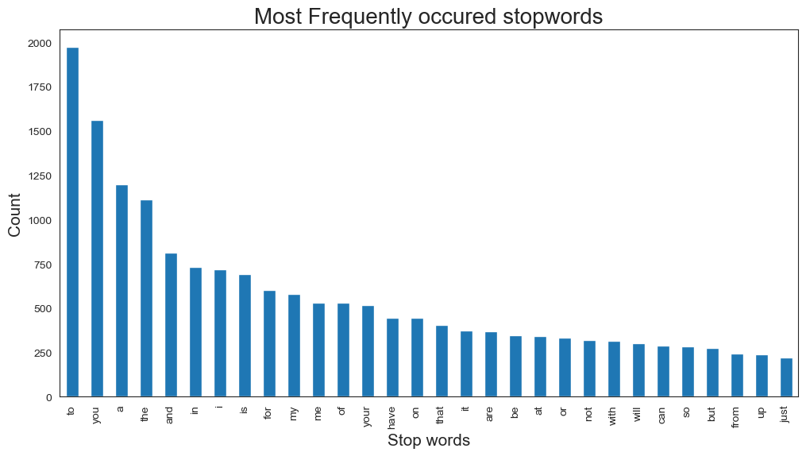
Stop words
After analyzing the text data, it was observed that certain words appeared more commonly than others. These included common stopwords like “to", “you", "a", "to", "and", "a", "for", "from", "is", "will", "on", and "by“ etc….

Slide 11

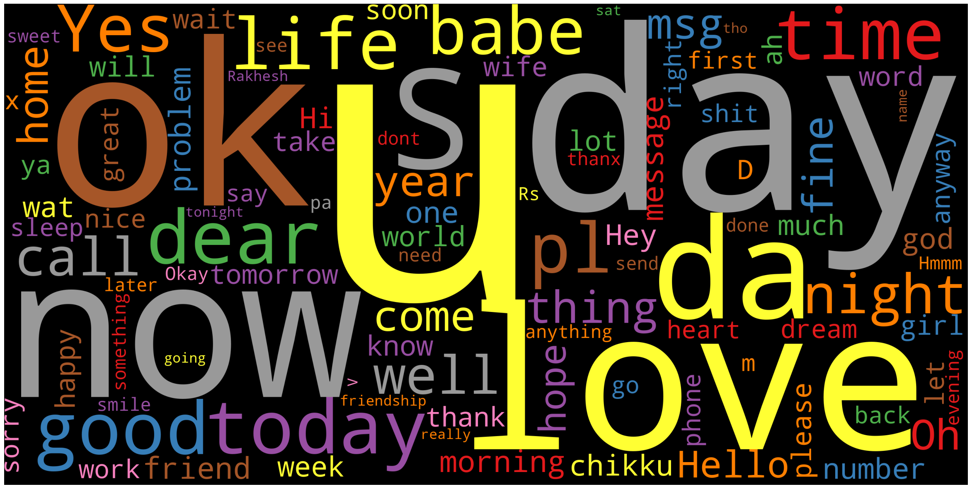
Analyzing on Ham words

Slide 12
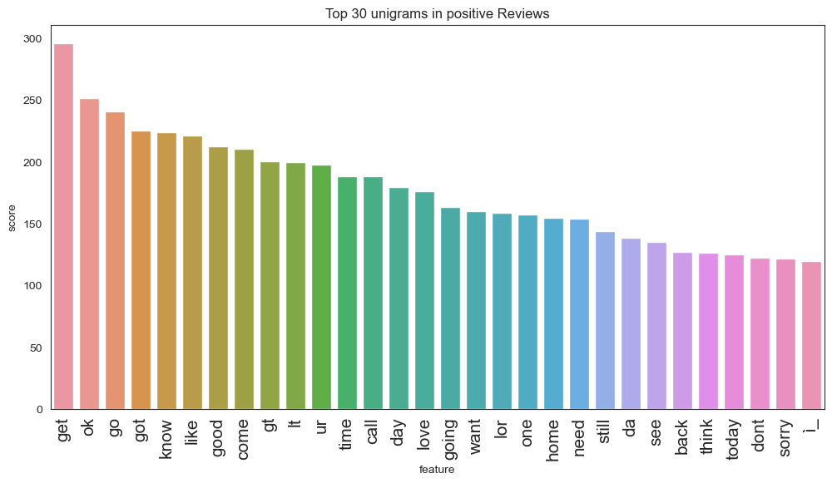
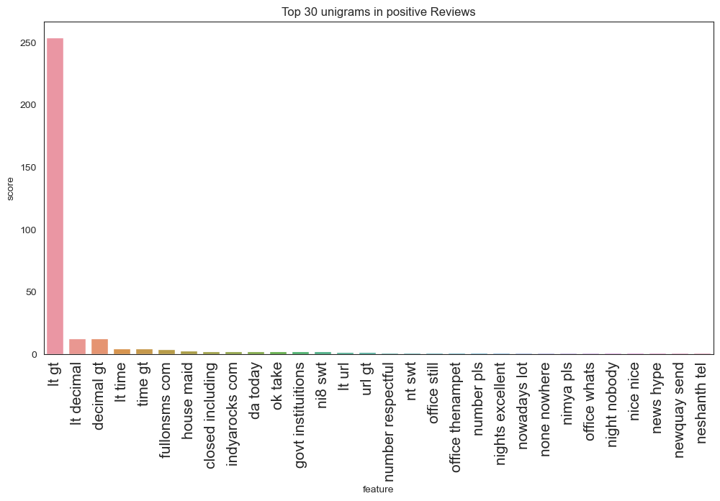
Unigram-ham reviews
The unigrams get,go,ok,got were found to be the most significant contributors in ham mails, based on analysis of the text data
Bigram-ham reviews
The most frequent bigrams in positive revews were found to be'ago cusoon', 'ah gee', 'ah sen', 'alaikkum pride', 'album quite'

Slide 13
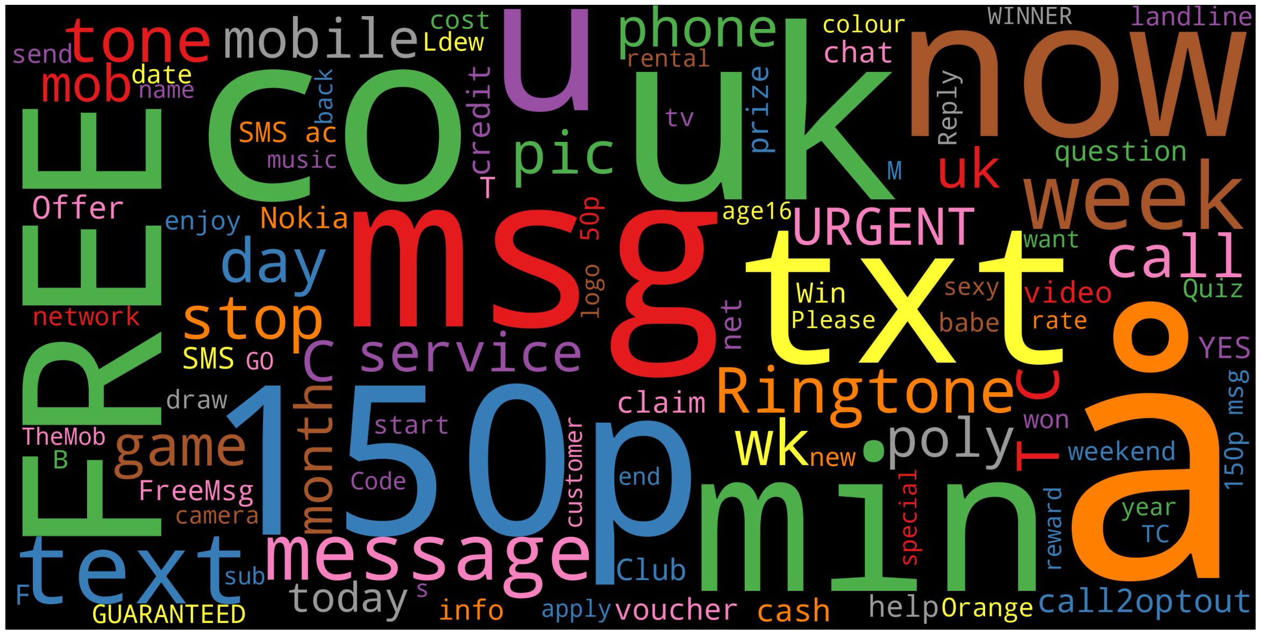
Analysing on Spam Mails

Slide 14

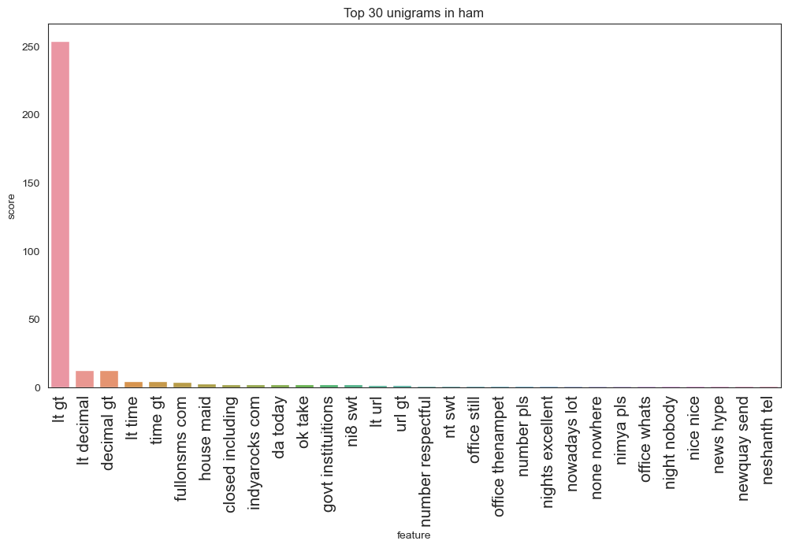
Unigram-Negative reviews
The unigrams "Eur", "mn", "sales", "company", "profit", “operating’,”Finnish” and "net" were found to be the most significant contributors in Negative reviews, based on analysis of the text data
Bigram-Negative reviews
The most frequent bigrams in Negative reviews were found to be "year year", “layoffs”,”Coca cola”, "non recurring", "three month", "pre tax", and "six month“.

Slide 15
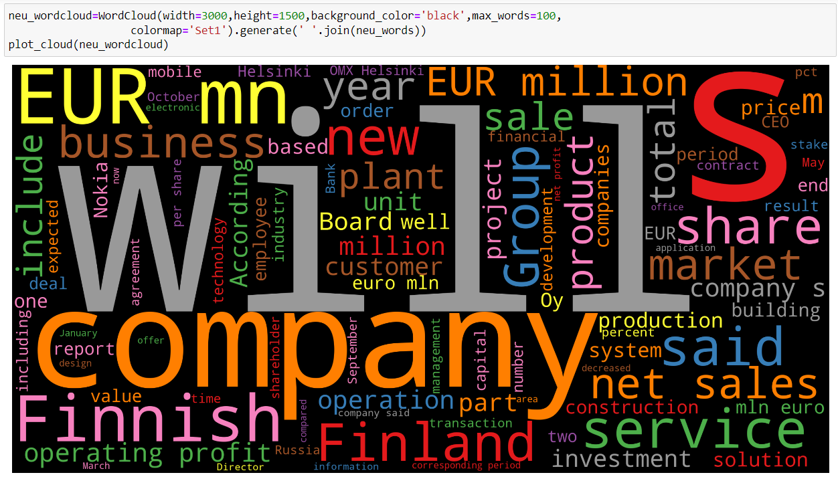
Analysing on Neutral reviews

Slide 16
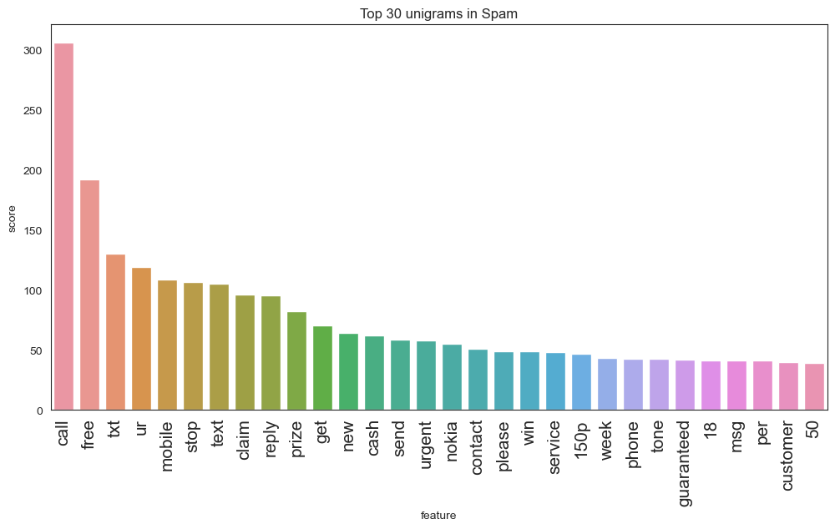
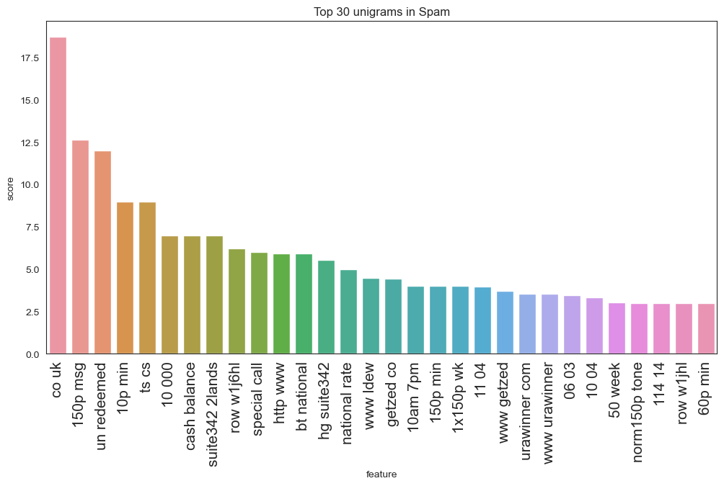
Unigram-Neutral reviews
The unigrams “call”,”text”,”free” were found to be the most significant contributors in Neutral reviews, based on analysis of the text data
Bigram-Neutral reviews
The most frequent bigrams in Negative reviews were found to be”co uk”,150p msg,10p min.

Slide 17
Text Preprocessing
Convert all text to lowercase to ensure consistency and avoid confusion caused by case sensitivity.
Remove stop words, such as "the," "and," "or," which are commonly occurring words that don't add much meaning to the text.
Stemming or lemmatization to reduce the words to their root form and improve the efficiency of the analysis.
Remove special characters, punctuation, and numbers to simplify the text and avoid confusion caused by irrelevant data.
Tokenize the text into individual words or phrases to analyze them effectively.

Slide 18
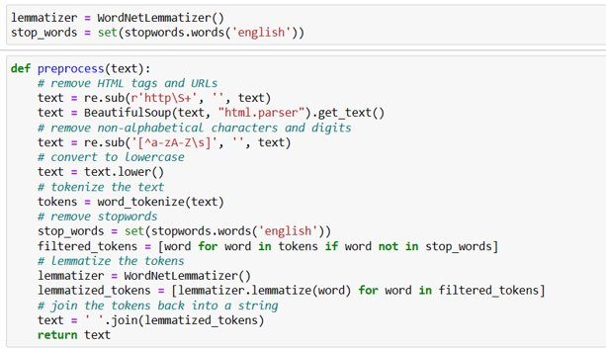
Text Preprocessing
Transforming Text into Data Structures:
Tokenization: It is One of the Fundamental Things to do in Any Text-Preprocessing Activity. It Breaks the Documents or Sentences into Chunks called Tokens. Each Token Carries a semantic meaning Associated with it.
{converting byte to byte}
Example: The capital of China is Beijing
Tokens : capital China Beijing
Grammatical Words : Stops words { The, of , is }

Slide 19
Text Preprocessing
Processing
Normalization
Makes the Data Standardized
Makes Everything in Small [Lower Case]
Remove Punctuation Marks
Removing Low and High Frequency Words
Low Frequency – outliners
High Frequency – Obvious Words
Removing So Called Stop-Words
Grammatical Words
Location stopwords
Time stopwords
Reducing Words to Their Root Form Through Stemming or Lemmatization.
Stemming : Reduces the words to its root form[Removes last 2 – 3 words]
Lemmatization(Real life) : It has a dictionary, it also reduce to its root word [Without Removing Last Letters]

Slide 20

Term Frequency – Inverse Documents Frequency
TF – IDF Approach Follows a weights Scheme Based on the High/Low Frequency of Words for in a Text Corpus.TF-IDF is also an occurrence-based method for vectorizing text and extracting features out of it. It is a composite of two terms, which are described as follows

Slide 21
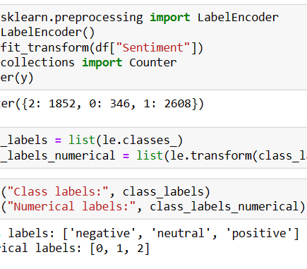
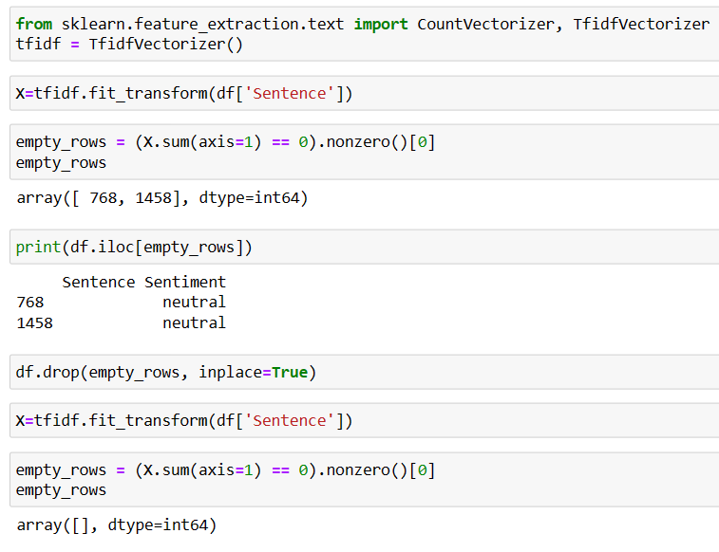
Term Frequency – Inverse Documents Frequency

Slide 22
MODEL BUILDING

Slide 23
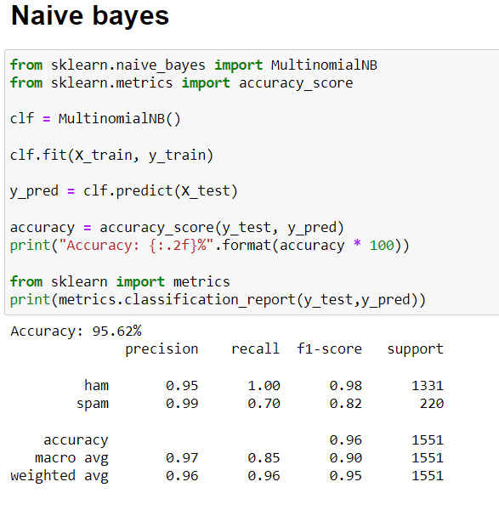
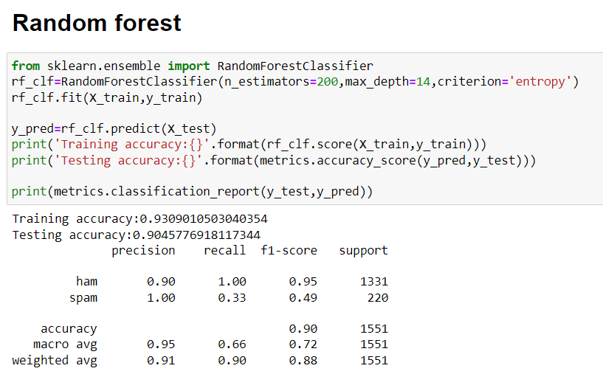

Slide 24
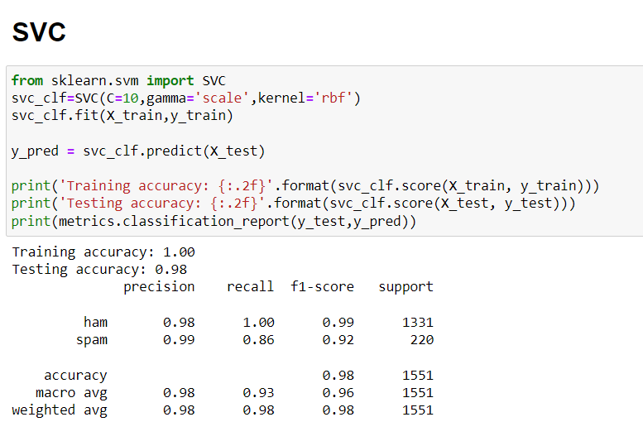
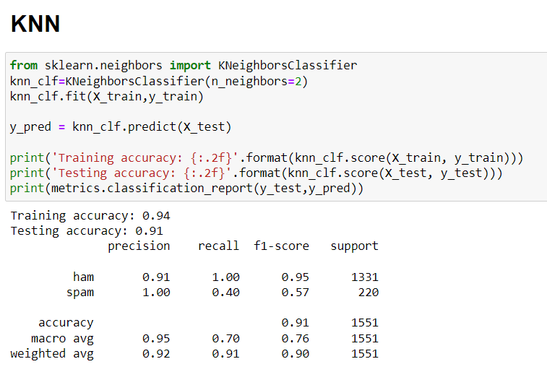
Out of all the models support vector model is performing good also we need to improve the recall as well so will try the smote up sampling method since the data is imbalanced

Slide 25
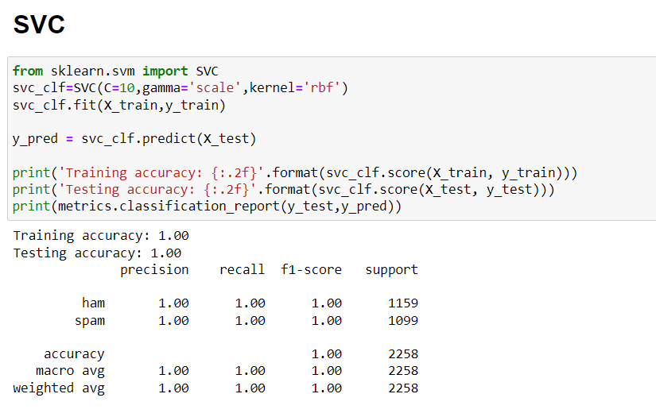
After resampling using smote:

Slide 26
Points to be noted:
worked on a ham spam mail classification project using machine learning techniques.
prepared a base model using multiple algorithms, including SVM, Naive Bayes, KNN, and Random Forest, to classify emails into spam and non-spam categories.
You found that the dataset was imbalanced, which can lead to biased classification results and poor performance of the model. To address this issue, you applied the SMOTE method to balance the dataset by generating synthetic examples of the minority class.
After applying the SMOTE method, you achieved a test accuracy and training accuracy of 100%, indicating that the model can accurately classify emails into spam and non-spam categories. You also obtained a cross-validation score of 0.9964571285299264, which indicates that the model performs well on unseen data.
Your work demonstrates your ability to use machine learning algorithms and techniques to solve a real-world problem related to email filtering and text classification. By applying the SMOTE method, you have shown your awareness of issues related to imbalanced datasets and your ability to address these issues using appropriate techniques.

Slide 27
Model Deployment

Slide 28
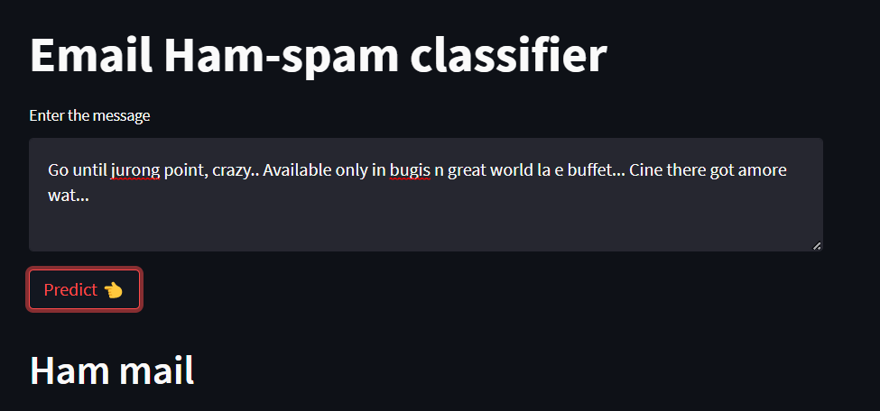
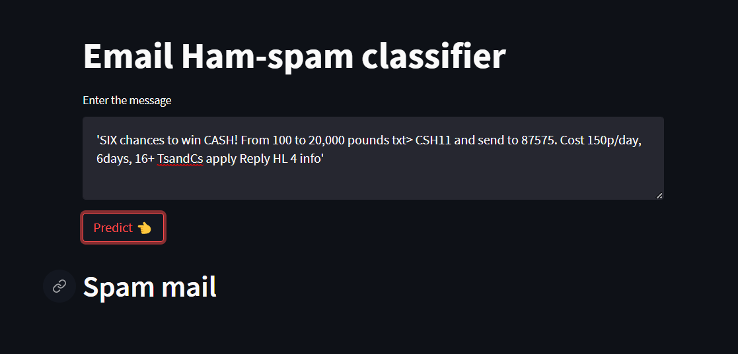

Slide 29
Summary of Deployment
The necessary libraries and packages are imported, including Streamlit, Pandas, NumPy, NLTK, BeautifulSoup , Gensim , and Spacy.
The code defines a preprocess() function that removes HTML tags, non-alphabetical characters, digits, stop words, and lemmatizes the text.
The code loads the Vectorized TF-IDF model from the specified path and the KNN classifier that was trained on a preprocessed dataset of financial reviews.
The code defines a Streamlit app that allows users to enter a financial review text and, on button press, preprocesses the text, generates a TFIDF vector representation of the text, and predicts the sentiment of the text using the KNN classifier.
The code displays the classes of a mail of the text as a header in the Streamlit app, with the classes being ham/spam

Slide 30
Thank You
Project by Madan K

